Slide 1
Counting
CSE 2213 – Discrete Mathematics

Slide 2
Basic counting principles
Product rule
Sum rule

Slide 3
The product rule

Slide 4
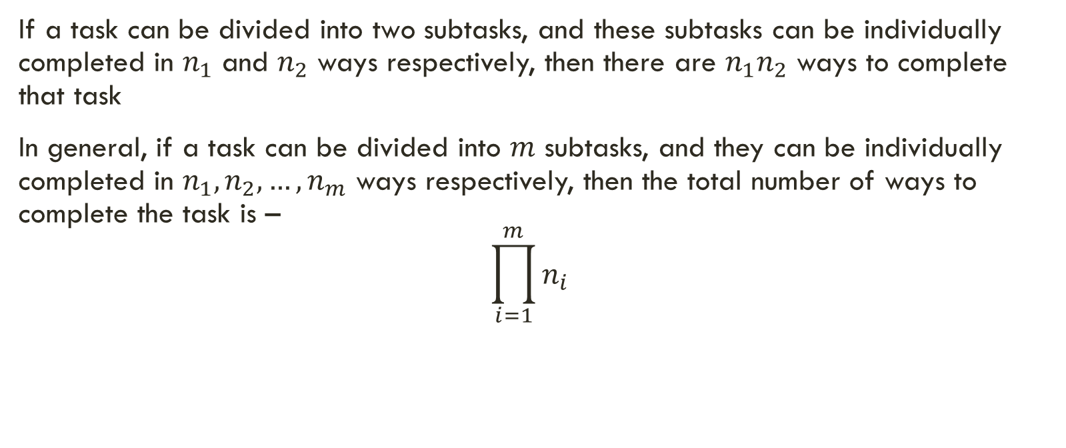
Product rule
If a task can be divided into two subtasks, and these subtasks can be individually completed in $n_{1}$ and $n_{2}$ ways respectively, then there are $n_{1}n_{2}$ ways to complete that task
In general, if a task can be divided into $m$ subtasks, and they can be individually completed in $n_{1},n_{2},…,n_{m}$ ways respectively, then the total number of ways to complete the task is – $\prod_{i=1}^{m}{n_{i}}$

Slide 5
Birthday treat
Suppose, you want to give birthday treat to your friends in a restaurant. The restaurant offers 3 main course (say, Biryani, Pizza, Pasta) and 2 types of cold drinks (Pepsi, 7Up). Your friend can choose one main course and one cold drink from the given options. How many different choices does your friend have to select the meal ?

Slide 6
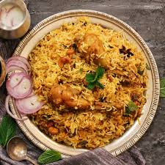
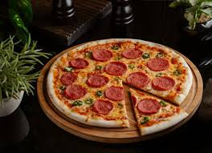
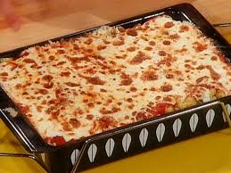
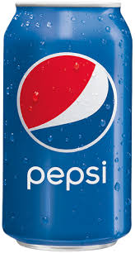

You have to select two items from the menu.
One from the main course, for that you have total three choices.
Another one from the cold drinks, for that you have two options.

Slide 7

If you choose Biryani, then you can take pepsi or 7up with it. Therefore, you have two different choices.

Slide 8
If you choose Pizza, then you can take pepsi or 7up with it. Therefore, you have two choices.

Slide 9
If you choose Pasta, then you can take pepsi or 7up with it. Therefore, you have two choices.

Slide 10
Solving a problem using product rule
Step one: Identify the subtasks
The subtasks SHOULD be done ONE AFTER THE OTHER to make the whole task possible
If you think about it, you will notice that the subtasks are going to be linked with an “AND” relationship
In our birthday treat problem, there are mainly two sub tasks:
Select food item from the main course
AND
Select cold drinks from the available cold drinks.
Step two: Count the possible ways for each subtask
Select food item from the main course: There are 3 ways to choose it.
Select cold drink from the available cold drinks: There are 2 ways to choose it.
Step three: Multiply the possible ways : 3 × 2 = 6 ways you can select the meal.

Slide 11
Example
There are twelve empty rooms in the office of Acme Softwares, inc. Alif and Laila joins the company. How many ways can they be assigned a room each from these twelve?

Slide 12
Total choice for Alif = 12

Slide 13
Alif
Total choice for Laila = 11

Slide 14
Alif
Total choice for Laila = 11

Slide 15
Total choice for Laila = 11
Alif

Slide 16
For every possible room assignment for Alif,
there are 11 choices for Laila
Total no. of assignments = 12x11 = 132
Alif

Slide 17
Example
What is the total number of bit strings of length 7?

Slide 18
Bit string
A string containing only 0’s and 1’s
A bit string of length 7 has 7 places to put a bit in
How many such bit strings are there?
PAUSE THE VIDEO, AND TRY YOURSELF

Slide 19
The problem has 7 subtasks – putting a bit in each of the 7 places
2 ways to
put a bit
2 ways to
put a bit
2 ways to
put a bit
2 ways to
put a bit
2 ways to
put a bit
2 ways to
put a bit
2 ways to
put a bit
Total number of ways = 2x2x2x2x2x2x2 = 2⁷ = 128

Slide 20
Example
How many different license plates are available if each plate contains a sequence of three lowercase letters followed by three digits (and no sequences of letters are prohibited)?

Slide 21
This problem has 6 sub tasks-putting three letters in the first three places and then three digits in the remaining the three places.
We has 26 letters in English and for digit (0-9)= total 10 different digits
26 letters
26 letters
26 letters
10 digits
10 digits
10 digits
Total number of license plates = 26x26x26x10x10x10 = 26³ x10³

Slide 22
The sum rule

Slide 23
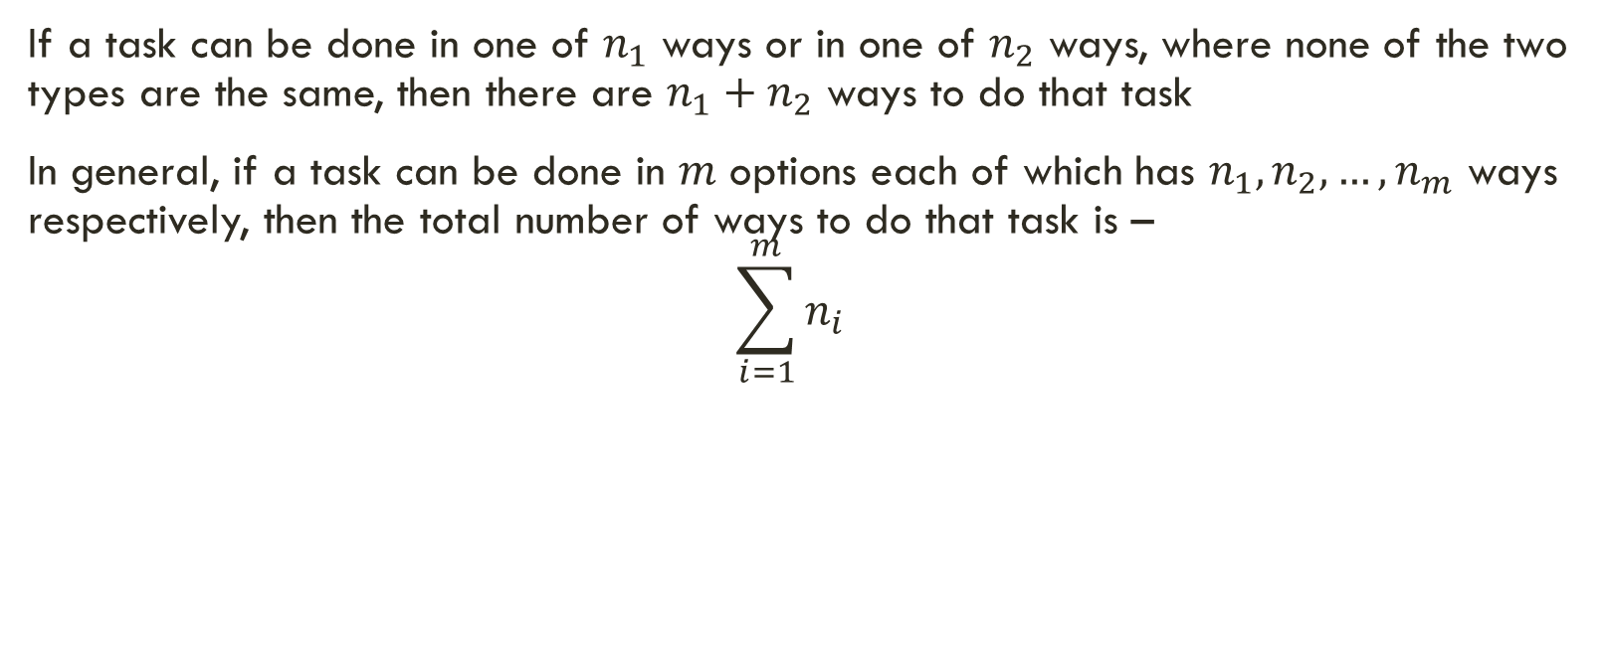
The sum rule
If a task can be done in one of $n_{1}$ ways or in one of $n_{2}$ ways, where none of the two types are the same, then there are $n_{1}+n_{2}$ ways to do that task
In general, if a task can be done in $m$ options each of which has $n_{1},n_{2},…,n_{m}$ ways respectively, then the total number of ways to do that task is – $\sum_{i=1}^{m}{n_{i}}$

Slide 24
Let’s travel from Dhaka to Chattogram
We can travel from Dhaka to Chattogram in bus, train or by air
How many buses are there?
Shohag, Green line, Hanif
How many trains are there?
Mahanagar, Subarna, Sonar Bangla, Turna
How many flights are there?
Novoair, US-Bangla
So how many ways we can travel?

Slide 25

travel example
Buses: Shohag, Green Line, Hanif$→$ 3
Trains: Mahanagar, Subarna, Sonar Bangla, Turna$→$ 4
Flights: Novoair, US-Bangla $→$ 2
Total = 3 + 4 + 2 = 9

Slide 26
Solving a problem using sum rule
Step one: Identify the different options of doing the SAME task
The different options are going to be mutually exclusive
If you think about it, you will notice that in order to carry out the task, you will choose one option or the other
That is, the different options are going to be connected with an OR relationship
Step two: Count the possible ways for each options
Step three: Add the possible ways

Slide 27
Example
Suppose that either a member of the mathematics faculty or a student who is a mathematics major is chosen as a representative to a university committee. How many different choices are there for this representative if there are 37 members of the mathematics faculty and 83 mathematics majors and no one is both a faculty member and a student?

Slide 28
Solution
1.Identify the different options:
Option 1:To choose representative from students who are mathematics major.
Option 2: To choose representative from mathematics faculty.
2. Count the possible ways for each options
Option 1: 83 students
Option 2: 37 Faculty members
3. Add the possible ways
83+37= 120 ways

